Slide 1
CTMC – Continuous Time Markov Chains
Christian M. Adriano (Chris)
christian.adriano@hpi.de
Notes:
https://en.wikipedia.org/wiki/Transduction_(machine_learning)

Slide 2
Topics
Questions w.r.t. CTMC
Data Sampling
Fitting Distributions

Slide 3
Project-1: Use of DTMC to Predict Event Masking

Slide 4
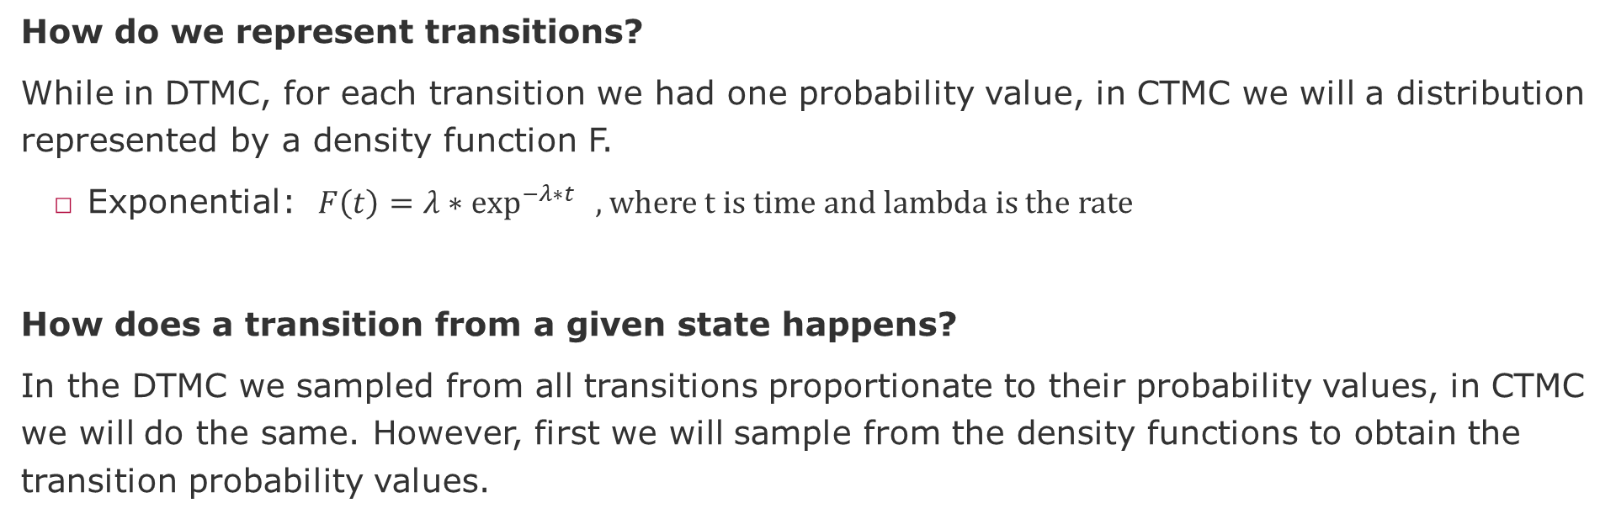
Questions
How do we represent transitions?
While in DTMC, for each transition we had one probability value, in CTMC we will a distribution represented by a density function F.
Exponential: $F\left(t\right)=λ∗\exp^{−λ∗t}{ }$, where t is time and lambda is the rate
How does a transition from a given state happens?
In the DTMC we sampled from all transitions proportionate to their probability values, in CTMC we will do the same. However, first we will sample from the density functions to obtain the transition probability values.

Slide 5
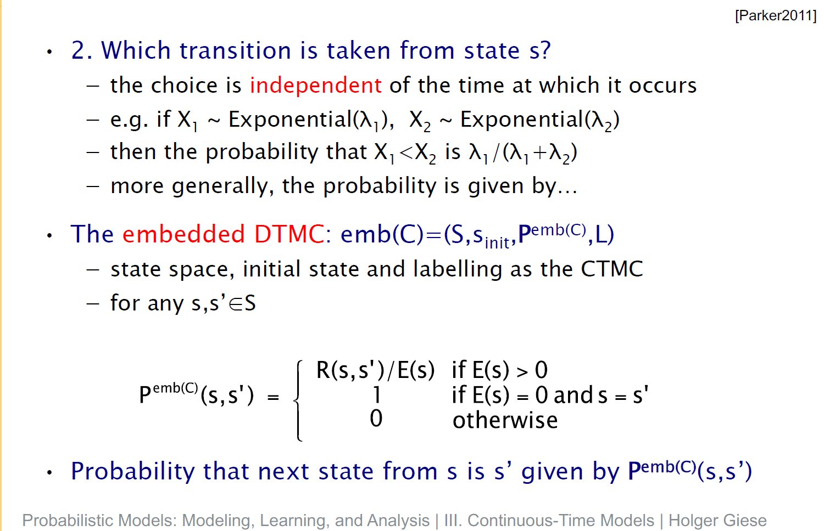
CTMC Race (multiple transitions possible)

Slide 6
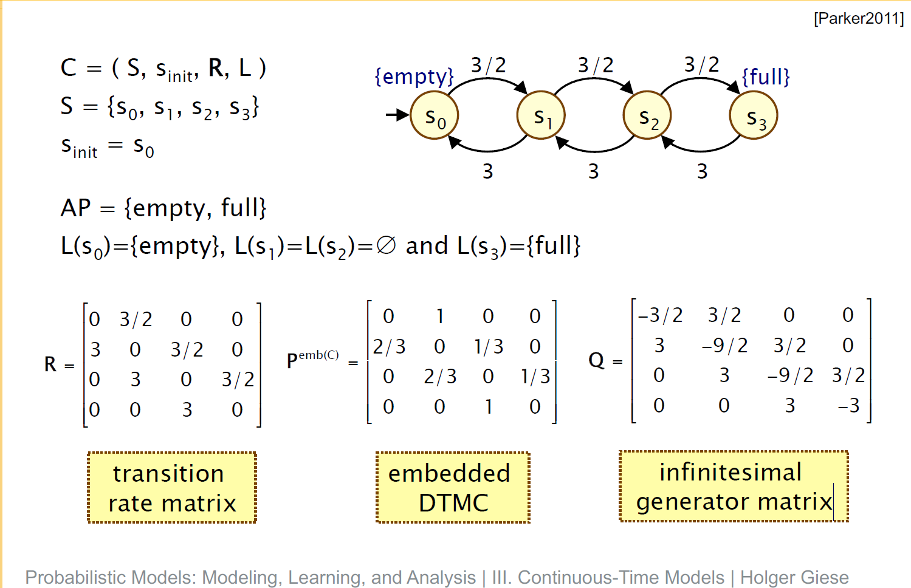
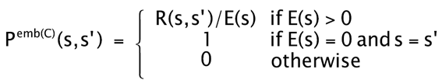
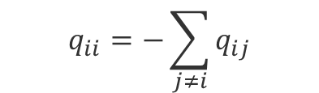
Example
$$q_{ii}=−\sum_{j≠i}{q_{ij}}$$

Slide 7
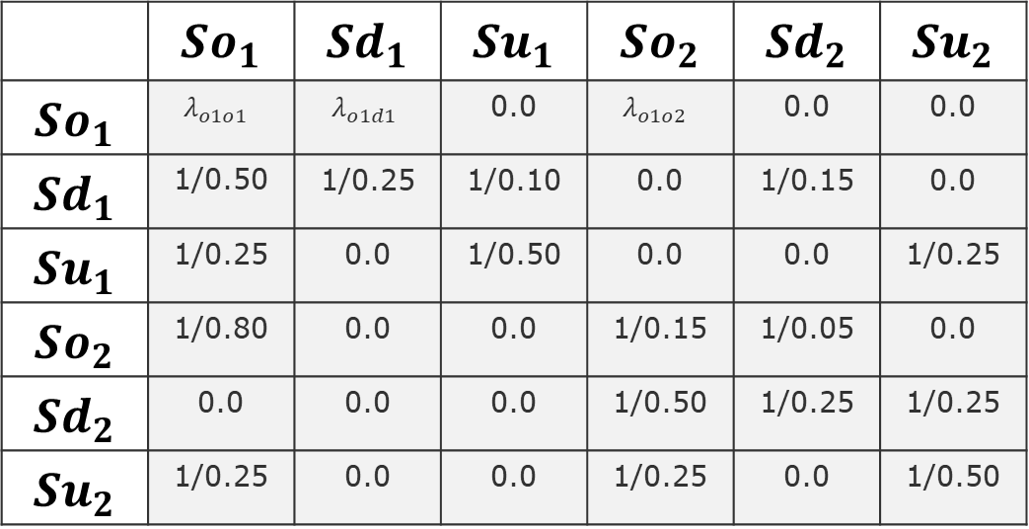
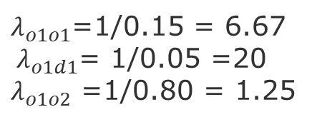
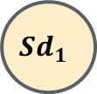



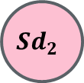




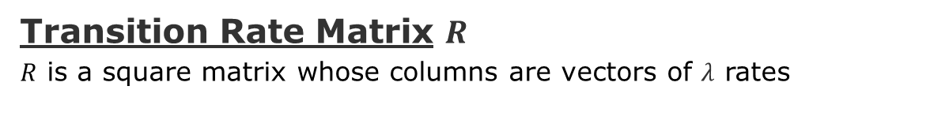
Example-1 of CTMC Markov Chain
$${ λ}_{o1d1}$$
Transition Rate Matrix $R$
$R$ is a square matrix whose columns are vectors of $λ$ rates
$$So_{1}$$
$$Sd_{1}$$
Targe states
$$λ_{o2o1}$$
 | $$So_{1}$$ | $$Sd_{1}$$ | $$Su_{1}$$ | $$So_{2}$$ | $$Sd_{2}$$ | $$Su_{2}$$
$$So_{1}$$ | $$λ_{o1o1}$$ | $${ λ}_{o1d1}$$ | 0.0 | $$λ_{o1o2}$$ | 0.0 | 0.0
$$Sd_{1}$$ | 1/0.50 | 1/0.25 | 1/0.10 | 0.0 | 1/0.15 | 0.0
$$Su_{1}$$ | 1/0.25 | 0.0 | 1/0.50 | 0.0 | 0.0 | 1/0.25
$$So_{2}$$ | 1/0.80 | 0.0 | 0.0 | 1/0.15 | 1/0.05 | 0.0
$$Sd_{2}$$ | 0.0 | 0.0 | 0.0 | 1/0.50 | 1/0.25 | 1/0.25
$$Su_{2}$$ | 1/0.25 | 0.0 | 0.0 | 1/0.25 | 0.0 | 1/0.50
$$Su_{1}$$
$$λ_{o1o2}$$
$$Su_{2}$$
Source states
$$So_{2}$$
$$Sd_{2}$$
Intentionally not showing the self-loops
$λ_{o1o1}$=1/0.15 = 6.67
${ λ}_{o1d1}$= 1/0.05 =20
$λ_{o1o2}$ =1/0.80 = 1.25

Slide 8







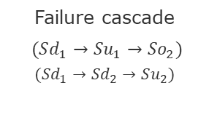
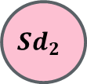






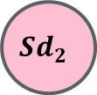
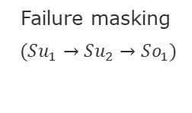




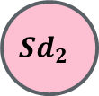


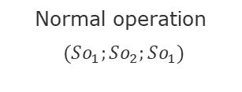









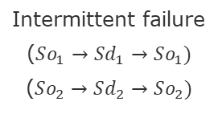
Types of Traces
$$So_{1}$$
$$Sd_{1}$$
$$So_{1}$$
$$Sd_{1}$$
$$So_{1}$$
$$Sd_{1}$$
$$So_{1}$$
$$Sd_{1}$$
$$So_{1}$$
$$Sd_{1}$$
$$Su_{1}$$
$$Su_{1}$$
$$Su_{1}$$
$$Su_{1}$$
$$Su_{1}$$
$$Su_{2}$$
$$Su_{2}$$
$$Su_{2}$$
$$Su_{2}$$
$$Su_{2}$$
$$So_{2}$$
$$Sd_{2}$$
$$So_{2}$$
$$Sd_{2}$$
$$So_{2}$$
$$Sd_{2}$$
$$So_{2}$$
$$Sd_{2}$$
$$So_{2}$$
$$Sd_{2}$$
Normal operation
$(So_{1};So_{2};So_{1})$
Intermittent failure
($So_{1}→Sd_{1}→So_{1})$
($So_{2}→Sd_{2}→So_{2})$
Systemic degradation
($Sd_{1}→Sd_{2})$
Failure masking
$(Su_{1}→Su_{2}→So_{1})$
Failure cascade
$(Sd_{1}→Su_{1}→So_{2})$
$$(Sd_{1}→Sd_{2}→Su_{2})$$

Slide 9

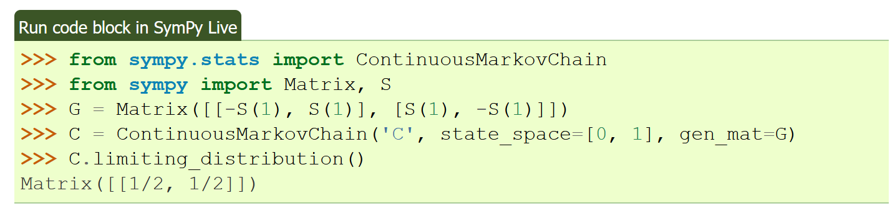
Task-1
Use the example from Sympy [1]
Compute the infinitesimal generator matrix Q (see example [2])
Simulate the example using Sympy (compute the limiting distributions)
Generator matrix
[1] https://docs.sympy.org/latest/modules/stats.html
[2] https://www.probabilitycourse.com/chapter11/11_3_3_the_generator_matrix.php

Slide 10
Task-2
For your MDP from project-3:
Estimate the rates
Sample timestamps from the DTMC (project-1)
Fit the exponential distributions for each transition
Adapt the code to use the density functions instead of the transition probabilities
Rerun the same convergence charts

Slide 11
Collecting the data
Execute your RL environment and for each transition obtain the time since the execution started (initial timestamp minus current time).
Each tuple is composed by the transition type, transition order, timestamp.
Example: https://colab.research.google.com/github/hpi-sam/MarkovModels_Lecture/blob/main/CTMC_Transition_Timestamps.ipynb
For each episode of your agent, you will generate a sample of the timestamps for each transition.
Aggregate (join) the data from 20 episodes
This is the data that you will use to fit (learn) the density functions

Slide 12
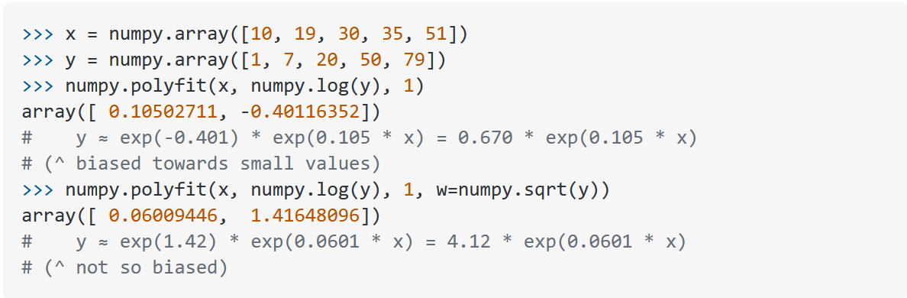
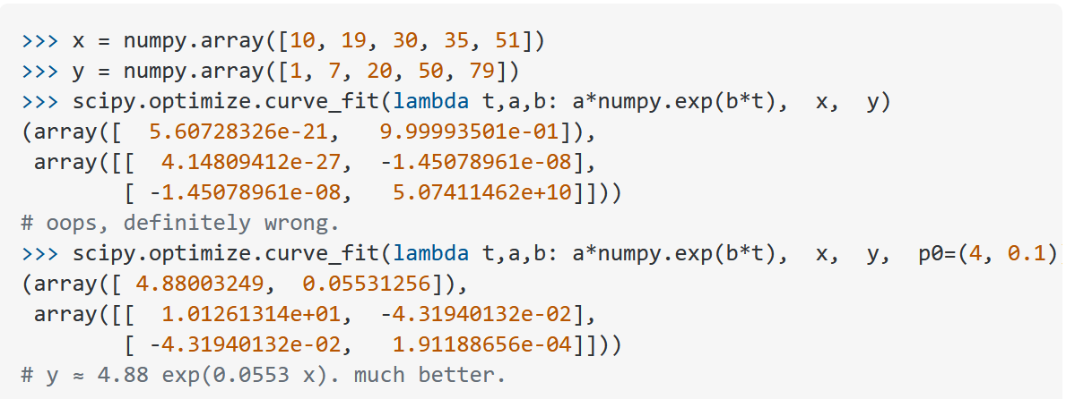
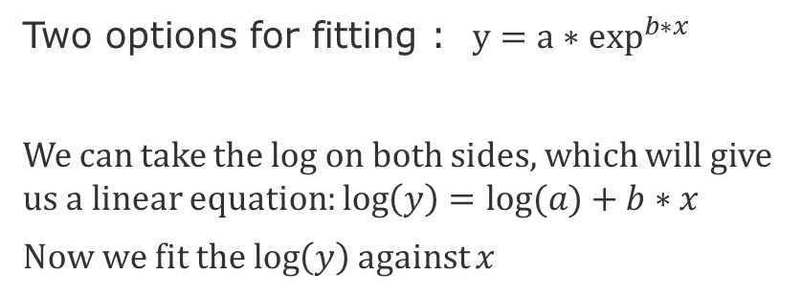
Fit the Exponential Density Function
Two options for fitting : $y=a∗\exp^{b∗x}{ }$
We can take the log on both sides, which will give us a linear equation: $\log\left(y\right)=log⁡(a)+b∗x$
Now we fit the $\log\left(y\right)$ against $x$
Solution with numpy.polyfit
Solution with scipy.optimize.curve_fit
Or we fit directly without transformation, but it requires and initialization to avoid invalid fit
source: https://stackoverflow.com/questions/3433486/how-to-do-exponential-and-logarithmic-curve-fitting-in-python-i-found-only-poly

Slide 13
References
Metzner, Philipp, et al. "Generator estimation of Markov jump processes." Journal of Computational Physics 227.1 (2007): 353-375. http://publications.imp.fu-berlin.de/35/1/MeDiJaSc07.pdf

Slide 14
End

Slide 15
Supervisory Component

